Slide 1

Spotify Data Analysis By: Puddin In The Work
“Music is the shorthand of emotion” Leo Tolstoy
Notes:
Presenting this data was made possible by the contributions of three team members: Jasmine C. Jillian K. Neetha HR. Teaming up together allowed us to bring strong data analysis skills paired with high artistic value. The years 2020 onward were a time when humanity were seeking connection. When the world was still and we had the ability to connect with ourselves, music became a go to for the connectedness humanity was seeking. Streaming platforms became more useful which allowed the collection of data that we will be interpreting today. Observing the Spotify charts from the year 2020-2023 Team Puddin In The Work found that the key and mode of music produced, streamed, and played correlated to the human connectedness we were all seeking.

Slide 2
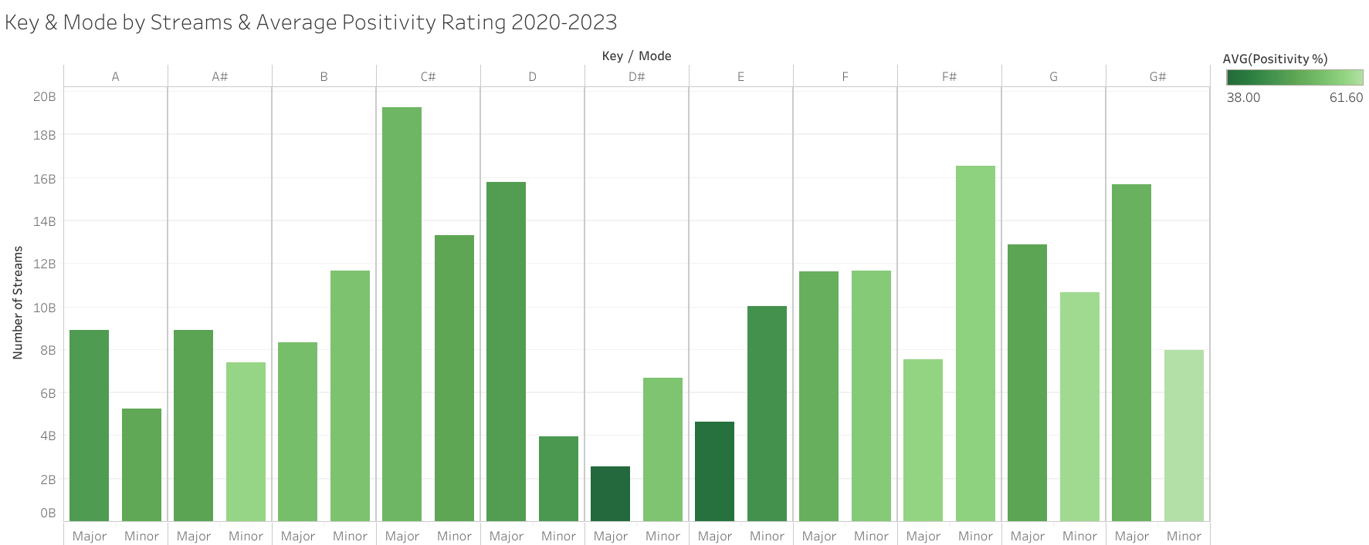
Streams for each Mode are broken down by Key. The color shows the average of the Positivity rating. The data is filtered by Release Year, which ranges from 2020 to 2023. The view is filtered on Key, which excludes any empty values.

Slide 3
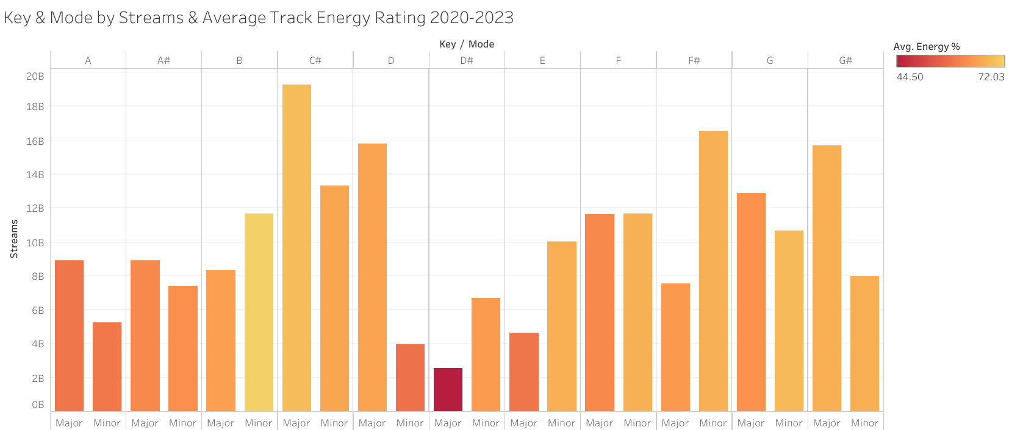
Streams for each Mode are broken down by Key. The color shows the average of the Energy rating. The data is filtered on Release Year, which ranges from 2020 to 2023. The view is filtered on Key, which excludes any empty values.

Slide 4
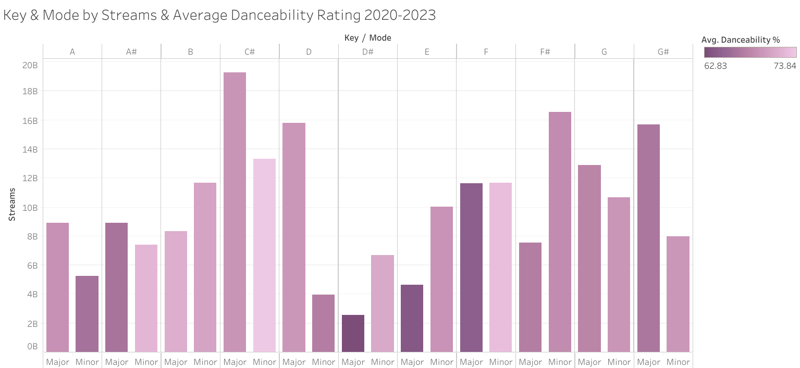
Streams for each Mode are broken down by Key. The color shows the average of the Danceability rating. The data is filtered on Release Year, which ranges from 2020 to 2023. The view is filtered on Key, which excludes any empty values.

Slide 5
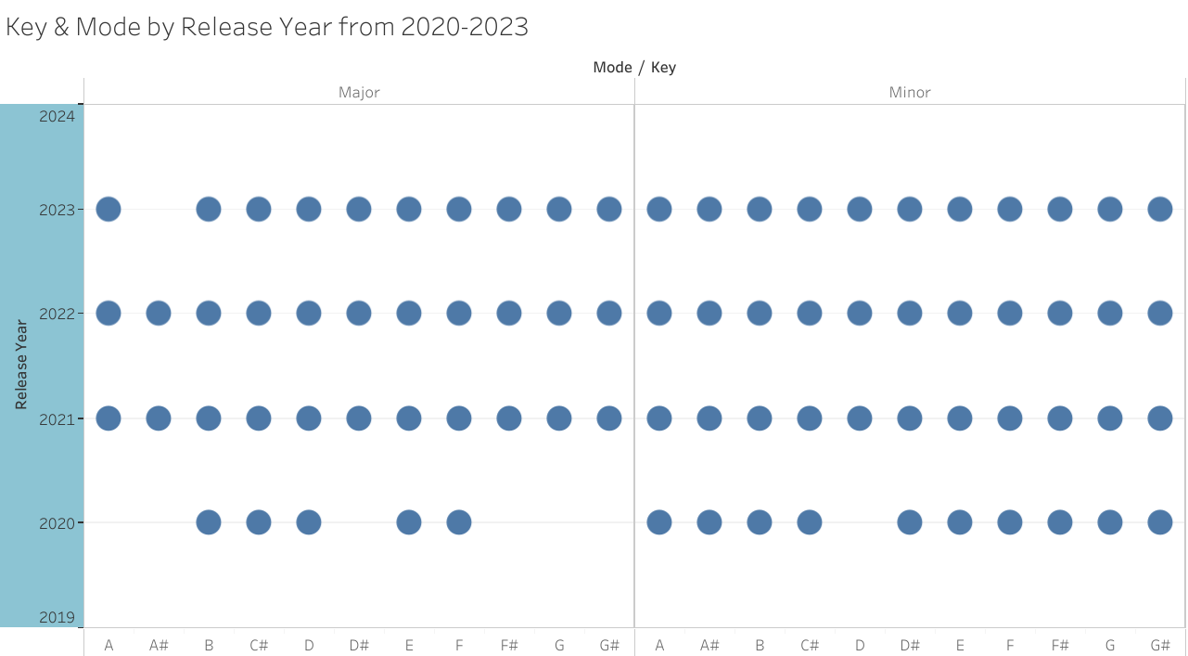
Released Year for each Key is broken down by Mode. The view is filtered on Key and Release Year. The Key filter excludes any empty values. The Release Year filter ranges from 2020 to 2023.

Slide 6
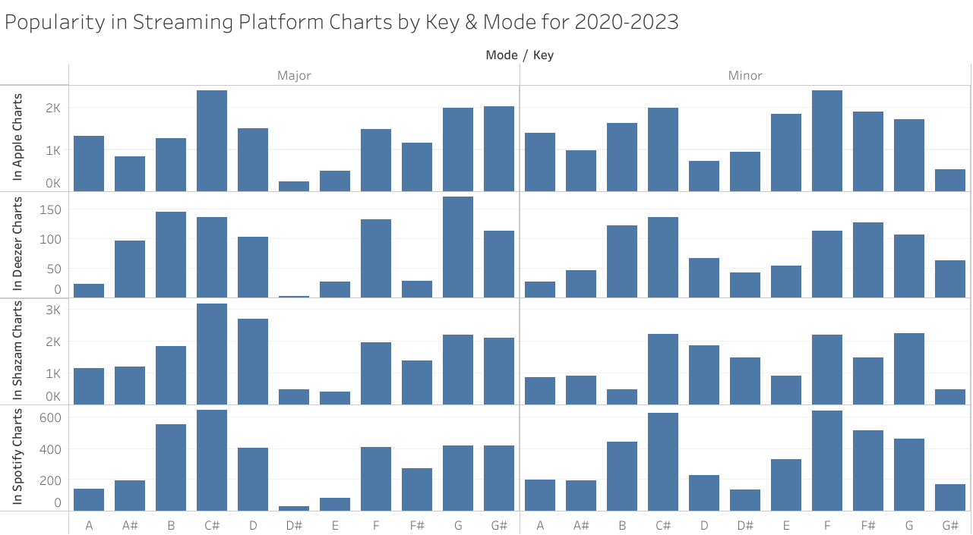
Rating In Apple Charts, Deezer Charts, Shazam Charts, and in Spotify are a total accumulation of streams. Each mode is broken down by Key. The data is filtered on Released Year, which ranges from 2020 to 2023. The view is filtered on Key, which excludes any empty values.

